Slide 1
Global Directory
A global directory in a distributed database system is a centralized or distributed catalog that keeps metadata about:
Data locations
Data fragmentation
Replication details
Schema definitions
It acts as a map to locate where data resides across multiple sites in the distributed system.

Slide 2
Global Directory
Table Name | Fragment Type | Site Location | Fragment Condition | Replica Info
Customers | Horizontal | Site_A (USA) | Country = 'USA' | Primary
Customers | Horizontal | Site_B (UK) | Country = 'UK' | Secondary
Orders | Vertical | Site_C (India) | OrderID, CustomerID | Primary
Orders | Vertical | Site_D (Germany) | OrderDate, Amount | Secondary
Products | Replicated | Site_A, Site_B | Full Table | Synchronous

Slide 3
Global Directory
Table Name: The name of the logical table.
Fragment Type: Indicates whether the table is horizontally or vertically fragmented, or fully replicated.
Site Location: The physical or logical location where the fragment or replica is stored.
Fragment Condition: The condition used to fragment the table (e.g., by country or by column).
Replica Info: Indicates whether the replica is primary, secondary, synchronous, or asynchronous.

Slide 4
Global Directory Issues
1. Location Transparency
Problem: Users should not need to know where data is physically stored.
Challenge: Maintaining this abstraction while ensuring efficient data access.
2. Directory Management
Centralized Directory:
Easy to manage and update.
Drawback: Single point of failure and performance bottleneck.
Distributed Directory:
More fault-tolerant and scalable.
Drawback: Complex synchronization and consistency management.

Slide 5
Global Directory Issues
3. Consistency and Synchronization
Issue: Ensuring that all directory copies (in a distributed setup) are consistent.
Techniques:
Periodic synchronization
Distributed consensus protocols (e.g., Paxos, Raft)
4. Scalability
As the number of nodes and data grows, the directory must scale.
Challenge: Avoid performance degradation due to directory lookup overhead.
5. Fault Tolerance
Problem: Directory failure can disrupt the entire system.
Solution: Replication and redundancy of directory data.
6. Security and Access Control
Directory contains sensitive metadata.
Challenge: Prevent unauthorized access and ensure secure updates.

Slide 6
Directory Placement Strategies
Strategy | Description | Pros | Cons
Centralized | Single site holds the directory | Simple, easy to manage | Bottleneck, single point of failure
Fully Replicated | Every site has a full copy | High availability | High update cost
Fragmented | Each site holds part of the directory | Scalable, localized access | Complex lookups

Slide 7
Fragmentation
Fragmentation is the process of dividing a database into smaller parts (fragments) to improve performance, manageability, and availability in a distributed database system.
Horizontal Fragmentation
Horizontal fragmentation divides a table into subsets of rows (tuples), where each fragment contains a subset of the rows based on a condition.
When to Use:
When different sites access different subsets of rows.
When queries are region-specific or department-specific.
How to Use:
Use WHERE clauses to define row subsets.

Slide 8
Example
-- Fragment 1: Employees in Kathmandu
CREATE TABLE Employees_KTM AS
SELECT * FROM Employees WHERE Location = 'Kathmandu';
-- Fragment 2: Employees in Pokhara
CREATE TABLE Employees_PKR AS
SELECT * FROM Employees WHERE Location = 'Pokhara';
CREATE TABLE Employees (
EmpID INT,
Name VARCHAR(50),
Department VARCHAR(50),
Location VARCHAR(50)
);

Slide 9
Example
CREATE TABLE Employees (
EmpID INT PRIMARY KEY,
Name NVARCHAR(50),
Department NVARCHAR(50),
Location NVARCHAR(50)
);
-- Query only Kathmandu employees
SELECT * FROM Employees_KTM;
-- Fragment 1: Employees in Kathmandu
SELECT * INTO Employees_KTM
FROM Employees
WHERE Location = 'Kathmandu';
-- Fragment 2: Employees in Pokhara
SELECT * INTO Employees_PKR
FROM Employees
WHERE Location = 'Pokhara';
-- Combine all fragments
SELECT * FROM Employees_KTM
UNION ALL
SELECT * FROM Employees_PKR;

Slide 10

Horizontal Fragmentation
Pros
Improved Performance for Local Queries
Example: If a branch office in Kathmandu only queries employees in Kathmandu, storing those rows locally reduces query time.
Benefit: Minimizes data transfer and latency.
Better Data Locality
Example: Sales data for different regions can be stored at regional servers.
Benefit: Enhances access speed and reduces network load.
Parallel Processing
Example: Queries on different fragments (e.g., Kathmandu and Pokhara) can be processed simultaneously.
Benefit: Increases throughput and efficiency.
Security and Privacy
Example: Sensitive data for a region can be isolated to that region’s server.
Benefit: Limits exposure and improves compliance.

Slide 11

Horizontal Fragmentation
Cons
Complex Query Processing
Example: A query needing data from all regions must access multiple fragments.
Drawback: Requires query decomposition and result merging.
Data Redundancy in Derived Fragmentation
Example: If fragmentation is based on a related table, redundancy may occur.
Drawback: Increases storage and maintenance cost.
Difficult Global Constraints Enforcement
Example: Enforcing a unique constraint across all fragments is complex.
Drawback: May lead to data integrity issues.

Slide 12
Vertical Fragmentation
Vertical fragmentation divides a table into subsets of columns (attributes), usually including the primary key in each fragment to allow reconstruction.
When to Use:
When different applications or sites access different columns.
To reduce the amount of data transferred.
How to Use:
Use SELECT with specific columns.

Slide 13
Example
-- Fragment 1: Basic Info
CREATE TABLE Emp_Basic AS
SELECT EmpID, Name FROM Employees;
-- Fragment 2: Work Info
CREATE TABLE Emp_Work AS
SELECT EmpID, Department, Location FROM Employees; To reconstruct:
SELECT * FROM Emp_Basic
JOIN Emp_Work USING (EmpID);

Slide 14
Example
CREATE TABLE Employees (
EmpID INT PRIMARY KEY,
Name NVARCHAR(50),
Department NVARCHAR(50),
Location NVARCHAR(50),
Salary DECIMAL(10, 2)
);
-- Query only personal info
SELECT * FROM Emp_Personal;
-- Join fragments to get full employee data
SELECT p.EmpID, p.Name, w.Department, w.Location, w.Salary
FROM Emp_Personal p
INNER JOIN Emp_Work w ON p.EmpID = w.EmpID;
-- Fragment 1: Personal Info
SELECT EmpID, Name INTO Emp_Personal
FROM Employees;
-- Fragment 2: Work Info
SELECT EmpID, Department, Location, Salary INTO Emp_Work
FROM Employees;

Slide 15
Vertical Fragmentation
Pros
Reduced Data Transfer
Example: A payroll system only needs EmpID, Name, and Salary, not Address or Department.
Benefit: Only relevant columns are accessed, saving bandwidth.
Improved Security
Example: Store sensitive columns (e.g., salary) separately with restricted access.
Benefit: Enhances data protection.
Optimized Storage
Example: Frequently accessed columns can be stored on faster storage.
Benefit: Improves performance for critical queries.

Slide 16
Vertical Fragmentation
Cons
Join Overhead
Example: To get full employee details, fragments must be joined on EmpID.
Drawback: Increases query complexity and execution time.
Update Anomalies
Example: Updating EmpID requires changes in all fragments.
Drawback: Risk of inconsistency if not handled properly.
Complex Schema Management
Example: Managing multiple fragments with overlapping keys.
Drawback: Increases administrative overhead.

Slide 17
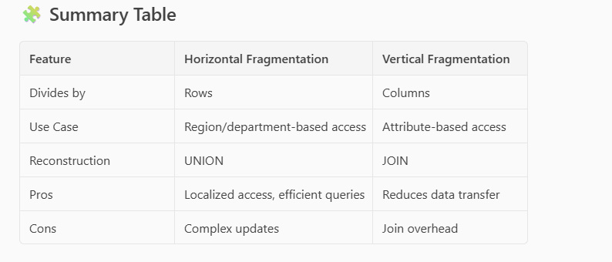
Summary

Slide 18
Semantic Data Control
Semantic Data Control refers to the mechanisms and rules used to ensure data consistency, integrity, and correctness across multiple sites in a distributed database system. It ensures that the meaning (semantics) of data remains consistent, even when data is fragmented, replicated, or accessed concurrently.
Key Objectives
Maintain data integrity across distributed sites.
Ensure semantic correctness of queries and updates.
Prevent anomalies due to fragmentation, replication, or concurrency.

Slide 19
Semantic Data Control - Objectives
Maintain Data Integrity Across Distributed Sites
Objective: Ensure that data adheres to defined rules (like constraints, relationships, and formats) even when spread across multiple locations.
Why It Matters:
In distributed systems, data is often fragmented or replicated.
Integrity rules (like primary keys, foreign keys, and domain constraints) must be enforced globally.
Example:
A Customer table is stored in Site A, and an Orders table is in Site B.
A foreign key in Orders referencing CustomerID must still be validated, even though the referenced data is on a different site.

Slide 20
Semantic Data Control - Objectives
Ensure Semantic Correctness of Queries and Updates
Objective: Ensure that queries and updates produce logically correct results, respecting the meaning and structure of the data.
Why It Matters:
Fragmentation (horizontal or vertical) can lead to partial views of data.
Queries must be rewritten or optimized to access all relevant fragments and return semantically correct results.
Example:
A query to find all customers in Asia must access fragments from multiple sites (e.g., India, China, Japan).
Semantic control ensures the query is reconstructed correctly to include all relevant data.

Slide 21
Semantic Data Control - Objectives
Prevent Anomalies Due to Fragmentation, Replication, or Concurrency
Objective: Avoid inconsistencies and errors caused by the distributed nature of the system.
Types of Anomalies:
Update Anomalies: Updating one replica but not others.
Read Anomalies: Reading stale or partial data.
Concurrency Anomalies: Conflicting updates from different users/sites.
Example:
If a product price is updated in Site A but not in Site B (replica), users may see different prices.
Semantic control ensures synchronization and conflict resolution mechanisms are in place.

Slide 22
Semantic Data Control
Data Consistency
Data consistency ensures that all users see the same data at the same time, regardless of which node they access in the distributed system.
Example:
Suppose a customer updates their shipping address on an e-commerce platform.
The update is made on Node A.
If Node B still shows the old address due to a delay in synchronization, the system is inconsistent.
A consistent system ensures that once the update is made, all nodes reflect the new address.

Slide 23
Semantic Data Control
Data Integrity
Definition: Data integrity ensures that the data is accurate, valid, and follows defined rules or constraints (like primary keys, foreign keys, and data types).
Example:
A Sales table has a foreign key referencing the Customers table.
If a sale is recorded for a customer ID that doesn’t exist in the Customers table, referential integrity is violated.
Distributed systems must enforce these constraints across nodes to maintain integrity.

Slide 24
Semantic Data Control
Data Correctness
Definition: Data correctness means the data reflects the real-world scenario it is supposed to model. It’s about the truthfulness of the data.
Example:
A bank’s distributed system shows a balance of $500 in one node and $700 in another for the same account.
Even if both are consistent within their nodes, only one can be correct.
Correctness ensures the data is not just consistent and valid, but also factually accurate.

Slide 25
Types of Semantic Data Control
1. Integrity Constraints Enforcement
Ensures that primary keys, foreign keys, and check constraints are maintained across all fragments.
Example: If EmpID is a primary key in one fragment, it must remain unique across all fragments.
2. Replication Control
Ensures that replicated data remains consistent across sites.
Example: If an employee’s salary is updated in one site, the change must reflect in all replicas.
3. Fragmentation Control
Ensures that horizontal or vertical fragments can be recombined without loss or duplication.
Example: Reconstructing a full Employees table from Emp_Personal and Emp_Work fragments.
4. Concurrency Control
Manages simultaneous access to data to prevent conflicts.
Example: Two users updating the same record at different sites must not cause inconsistency.
5. Semantic Query Optimization
Uses semantic knowledge (like constraints and relationships) to optimize distributed queries.
Example: Avoiding unnecessary joins if a foreign key guarantees a match.

Slide 26
View
CREATE VIEW view_name AS
SELECT column1, column2
FROM table_name
WHERE condition;
A view is a virtual table in a database that is defined by a SQL query. It does not store data physically, but presents data from one or more tables in a customized way.
Why Are Views Needed?
Purpose | Description
Data Security | Restrict access to specific rows or columns.
Simplification | Hide complex joins or calculations.
Data Abstraction | Provide a logical representation of data.
Consistency | Present a consistent format even if underlying schema changes.
Reusability | Encapsulate frequently used queries.

Slide 27
View
A view is called a virtual table because:
🔹 It behaves like a table:
You can query it using SELECT, just like a regular table.
It has columns and rows, defined by a SQL query.
🔹 But it is not physically stored:
A view does not store data itself.
It stores only the SQL query that defines it.
When you query a view, the database executes the underlying query in real-time and returns the result.

Slide 28
Types of Views
CREATE VIEW Simple_Emp_View AS
SELECT EmpID, Name FROM Employees;
Simple View
Based on a single table.
Does not include functions, joins, or groups.
Updatable.
Complex View
Based on multiple tables or includes joins, groups, or aggregates.
Not always updatable.
CREATE VIEW Dept_Salary_View AS
SELECT Department, AVG(Salary) AS AvgSalary
FROM Employees
GROUP BY Department;

Slide 29
Materialized View
Stores the result physically.
Used for performance optimization.
Needs to be refreshed periodically.
CREATE MATERIALIZED VIEW Sales_Summary
AS SELECT Region, SUM(Sales) FROM Orders GROUP BY Region;

Slide 30
Views
-- Complex view with a join, but still updatable in some cases
CREATE VIEW Emp_Dept_View AS
SELECT e.EmpID, e.Name, d.DeptName
FROM Employees e
JOIN Departments d ON e.Department = d.DeptID;
-- Base table
CREATE TABLE Employees (
EmpID INT PRIMARY KEY,
Name NVARCHAR(50),
Department NVARCHAR(50),
Salary DECIMAL(10, 2)
);
-- Simple view (based on one table, no joins or aggregates)
CREATE VIEW Simple_Emp_View AS
SELECT EmpID, Name, Salary
FROM Employees;
-- This may work if only columns from Employees are updated
UPDATE Emp_Dept_View
SET Name = 'John Doe'
WHERE EmpID = 101;
-- View with aggregation (not updatable)
CREATE VIEW Avg_Salary_View AS
SELECT Department, AVG(Salary) AS AvgSalary
FROM Employees
GROUP BY Department;
-- This update will work
UPDATE Simple_Emp_View
SET Salary = 60000
WHERE EmpID = 101;
-- This will fail
UPDATE Avg_Salary_View
SET AvgSalary = 70000
WHERE Department = 'HR';

Slide 31
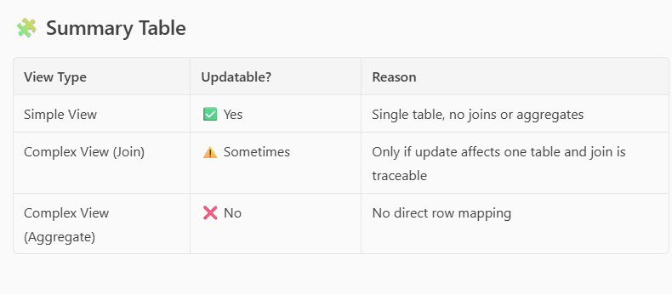

Slide 32
Update through Views
What is "Update Through Views"?
In a centralized DBMS, you can perform UPDATE, INSERT, or DELETE operations on a view, but only under certain conditions. Whether a view is updatable depends on how it is defined.
When Is a View Updatable?
A view is updatable if:
It is based on a single base table.
It does not contain:
Aggregate functions (SUM, AVG, etc.)
GROUP BY, DISTINCT, UNION
Joins (in most cases)
It includes the primary key of the base table.

Slide 33
Views in Distributed Database
In a distributed database, a view is a virtual table that is derived from one or more base tables or other views. It does not store data itself, but rather provides a way to query and present data from distributed sources in a unified manner.
What is a View in a Distributed Database?
A view is defined by a query.
It can combine data from multiple tables, even if those tables are located on different nodes in a distributed system.
Views help in data abstraction, security, and simplifying complex queries.

Slide 34
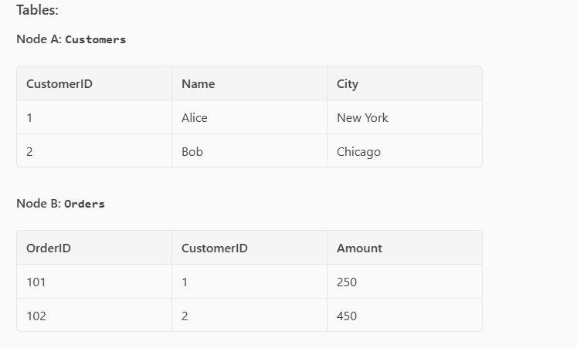
Views in Distributed Database
Let’s say we have a retail company with a distributed database:
Node A stores customer data.
Node B stores order data.

Slide 35
Views in Distributed Database
CREATE VIEW CustomerOrders AS
SELECT c.Name, o.Amount
FROM Customers c
JOIN Orders o ON c.CustomerID = o.CustomerID;
In a distributed setup, the database engine will fetch data from both nodes, perform the join, and present the result as a virtual table.
Benefits of Views in Distributed Databases
Data abstraction: Users don’t need to know where data is stored.
Security: Restrict access to sensitive columns.
Simplified queries: Hide complex joins or filters.
Consistency: Provide a consistent interface even if the underlying schema changes.

Slide 36
Views in Distributed Database
How Views Work in Distributed Databases
In a distributed database, data is stored across multiple physical locations (nodes). A view is a virtual table created by a query that can pull data from these different nodes.
What Happens When You Query a View?
View Definition: The view is defined using a SQL query that may involve tables from multiple nodes.
Query Execution Plan: The database engine creates a plan to fetch and combine data from the relevant nodes.
Data Retrieval: The engine sends sub-queries to each node to retrieve the necessary data.
Data Integration: The results from each node are combined (joined, filtered, etc.) at a central node or coordinator.
Result Presentation: The final result is presented to the user as if it came from a single table.

Slide 37
Views in Distributed Database
CREATE VIEW CustomerOrders AS
SELECT c.Name, o.Amount
FROM Customers c
JOIN Orders o ON c.CustomerID = o.CustomerID;
What Happens Internally?
User runs: SELECT * FROM CustomerOrders;
The system:
Sends a query to Node 1 to get CustomerID and Name.
Sends a query to Node 2 to get CustomerID and Amount.
The coordinator node:
Joins the two datasets on CustomerID.
Returns the result.

Slide 38

Challenges in Distributed - Views
1. Data Location Transparency
Challenge: Users may not know where the data physically resides, which can lead to inefficient queries.
Solution: Use a distributed query optimizer that understands data locality and minimizes data movement.
2. Network Latency
Challenge: Views that join tables across nodes can suffer from high latency due to data transfer over the network.
Solution:
Use materialized views to cache results.
Apply data replication or data partitioning strategies to reduce cross-node joins.
3. Data Consistency
Challenge: Views may show inconsistent data if underlying tables are updated at different times.
Solution:
Use synchronous replication or distributed transactions.
For materialized views, implement refresh policies (e.g., on commit, scheduled).

Slide 39

Challenges in Distributed - Views
4. Query Optimization
Challenge: Optimizing queries over views in a distributed setup is complex.
Solution:
Use cost-based optimizers that consider network cost, data size, and node load.
Rewrite views into more efficient subqueries when possible.
5. Security and Access Control
Challenge: Views may expose sensitive data from multiple sources.
Solution:
Apply row-level and column-level security.
Use view-based access control to restrict what users can see.
6. Fault Tolerance
Challenge: If a node fails, the view may become unavailable or incomplete.
Solution:
Implement redundancy and failover mechanisms.
Use replicated views or fallback nodes.
7. Maintenance Overhead
Challenge: Keeping views up to date, especially materialized ones, can be resource-intensive.
Solution:
Use incremental view maintenance.
Schedule off-peak refreshes to reduce load.

Slide 40
Data Security
Data security in distributed databases is crucial because data is stored across multiple locations, often over a network, which increases the risk of unauthorized access, data breaches, and inconsistencies. Here's a breakdown of the key aspects and strategies:
Key Aspects of Data Security in Distributed Databases
1. Authentication and Authorization
Authentication ensures only verified users can access the system.
Authorization controls what authenticated users are allowed to do.
Solution: Use role-based access control (RBAC), multi-factor authentication (MFA), and centralized identity management.

Slide 41
Data Security
2. Data Encryption
At Rest: Encrypt data stored on disk at each node.
In Transit: Encrypt data as it moves between nodes or to/from clients.
Solution: Use TLS/SSL for communication and AES for storage encryption.
3. Access Control
Prevent unauthorized access to sensitive data.
Solution: Implement fine-grained access control using views, policies, and user roles.

Slide 42
Data Security
4. Auditing and Monitoring
Track who accessed what data and when.
Solution: Enable logging and use intrusion detection systems (IDS) to monitor suspicious activity.
5. Data Integrity
Ensure data is not tampered with during transmission or storage.
Solution: Use checksums, digital signatures, and transaction validation mechanisms.
6. Replication Security
Replicated data across nodes must be secured to prevent unauthorized duplication.
Solution: Encrypt replicated data and restrict replication permissions.

Slide 43
Data Security
7. Backup and Recovery
Protect against data loss due to attacks or failures.
Solution: Use secure, encrypted backups and test recovery procedures regularly.
8. Compliance
Adhere to legal and regulatory standards (e.g., GDPR, HIPAA).
Solution: Implement data classification, retention policies, and ensure audit trails.

Slide 44
Centralized Authorization Control
Characteristics:
A single central authority manages all user permissions and access rights.
All access requests are routed through this central system.
Pros:
Simplified management: Easier to update and audit permissions.
Consistency: Uniform policies across the system.
Central logging: Easier to monitor and detect anomalies.
Cons:
Single point of failure: If the central server goes down, access may be blocked.
Scalability issues: May become a bottleneck in large systems.
Latency: Remote nodes must communicate with the central server for authorization.

Slide 45
Centralized Authorization Control
🔧 How It Works:
A central server (e.g., an identity and access management system) handles all user authentication and authorization.
Every time a user or application tries to access data, the request is sent to this central authority for permission.
📘 Example:
Imagine a company with a centralized database system:
Central Auth Server: Manages roles like Admin, Manager, Employee.
Database Nodes: Store data but rely on the central server for access decisions.
Scenario:
User Alice logs in and tries to access the Sales table.
The database node sends a request to the central auth server.
The server checks Alice’s role (Manager) and grants read access.
Alice gets the data.
✅ Benefit: Easy to manage and audit. ❌ Risk: If the central server fails, no one can access data.

Slide 46
Distributed Authorization Control
🌐 Distributed Authorization Control
✅ Characteristics:
Each node or subsystem manages its own access control.
Authorization decisions are made locally.
📌 Pros:
High availability: No single point of failure.
Scalable: Each node handles its own load.
Faster local decisions: Reduces latency.
❌ Cons:
Complex management: Harder to maintain consistent policies.
Security risks: Inconsistent rules may lead to vulnerabilities.
Audit difficulty: Logs are spread across nodes.

Slide 47
Distributed authorization control
🌐 Distributed Authorization Control
🔧 How It Works:
Each database node or region has its own local authorization rules.
Access decisions are made locally, without needing a central authority.
📘 Example:
A global company uses a distributed database:
Node A (USA): Manages North American data.
Node B (Europe): Manages European data.
Each node has its own access control list (ACL).
Scenario:
User Bob in Europe tries to access customer data.
Node B checks its local ACL and grants access.
No need to contact a central server.
✅ Benefit: Faster, more resilient. ❌ Risk: Harder to maintain consistent policies across nodes.

Slide 48
Centralized Integrity Control
What is Integrity Control?
Integrity control ensures that the data in a database is accurate, consistent, and reliable. It includes:
Entity integrity: Each row is uniquely identifiable (e.g., primary keys).
Referential integrity: Foreign keys correctly reference primary keys.
Domain integrity: Data values are valid (e.g., age must be a number).
Consistency rules: Business rules are enforced (e.g., balance ≥ 0).
Centralized Database Integrity Control
✅ How It Works:
All data is stored in a single location.
Integrity constraints are enforced centrally by the database engine.
📘 Example:
A centralized HR database:
Table: Employees

Slide 49
Centralized Integrity Control
CREATE TABLE Employees (
EmpID INT PRIMARY KEY,
Name VARCHAR(50),
DeptID INT,
FOREIGN KEY (DeptID) REFERENCES Departments(DeptID)
);
All constraints (primary key, foreign key) are enforced by the central DBMS.
✅ Benefits:
Easy to enforce and audit.
Strong consistency.
❌ Limitations:
Not scalable for large, geographically distributed systems.

Slide 50
Distributed integrity Control
✅ How It Works:
Data is spread across multiple nodes.
Integrity constraints must be enforced across nodes, which is more complex.
📘 Example:
A distributed e-commerce system:
Node A: Customers table
Node B: Orders table
You want to ensure that every Order.CustomerID exists in Customers.
But since the tables are on different nodes, enforcing this referential integrity requires:
Distributed transactions (e.g., two-phase commit)
Application-level checks
Replication or caching of key data

Slide 51
Distributed integrity Control
✅ Benefits:
Scalable and fault-tolerant.
❌ Challenges:
Harder to enforce referential integrity.
Risk of inconsistency during network failures.

Slide 52
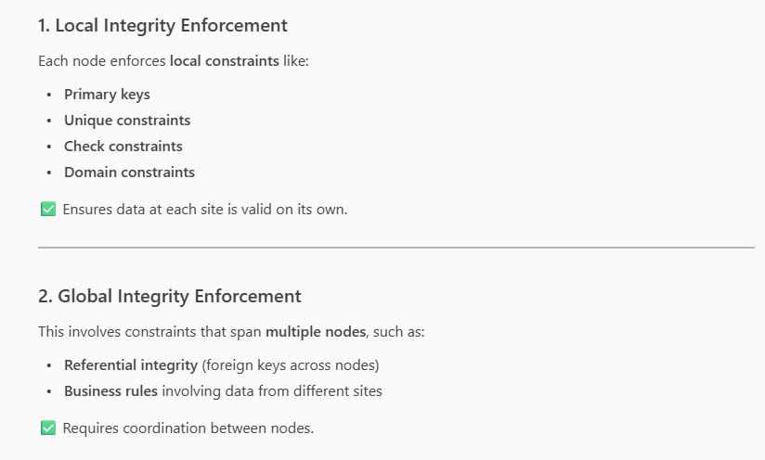
Distributed Integrity Control

Slide 53
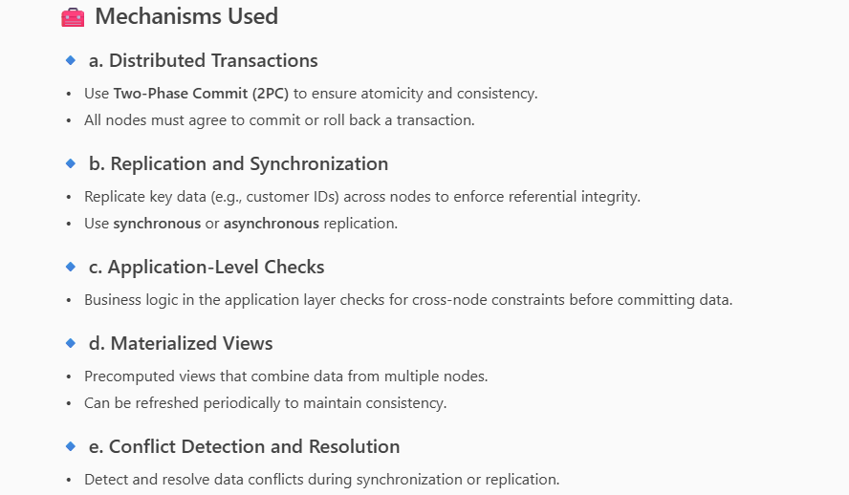
Distribued Integrity Control

